Slide 1
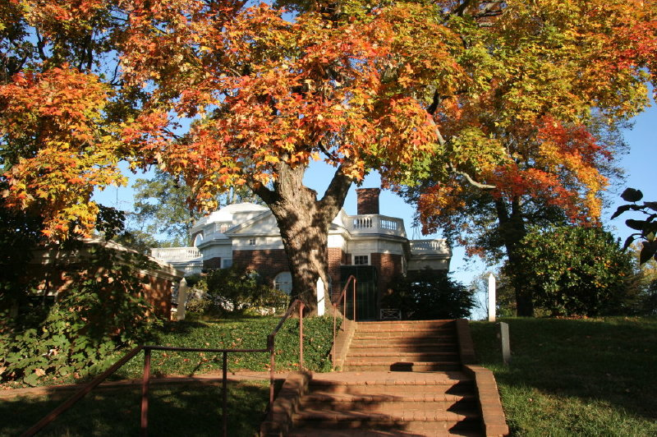
Science and the
Monticello Maples
Monticello photo.
Lecture for NR 435, February 2012
Martha Carlson, NRESS, University of New Hampshire
Copyright 2012 University of New Hampshire

Slide 2
UNH Forest Watch researchers visited Monticello in February 2012 to visit the Jefferson sugar maples.
We hypothesized that the Monticello maples might give us some insight into how New Hampshire’s sugar maples will respond to climate change.

Slide 3

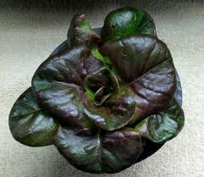
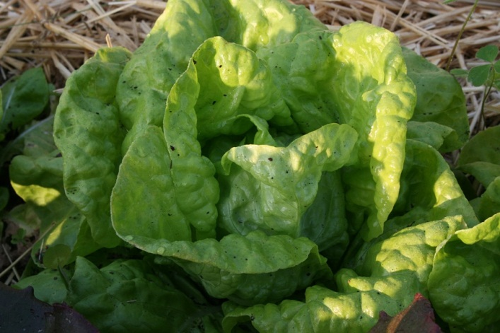
Jefferson, the Scientist
Thomas Jefferson tested 300 varieties of 70 species of vegetables, 1031 fruit trees, 24 varieties of grapes, and 130 species of trees.
"I am curious to select one or two of the best species or variety of every garden vegetable, and to reject all others from the garden to avoid the dangers of mixing or degeneracy,“ he wrote
Brown Dutch (top) and tennis ball lettuces.
Notes:
Squashes and broccoli from Italy, beans and salsify collected by Lewis and Clark, figs from France, and peppers from Mexico. Jefferson experimented with different varieties, carefully separating them so they would not cross pollenate—20 different beans, 15 different English peas.

Slide 4
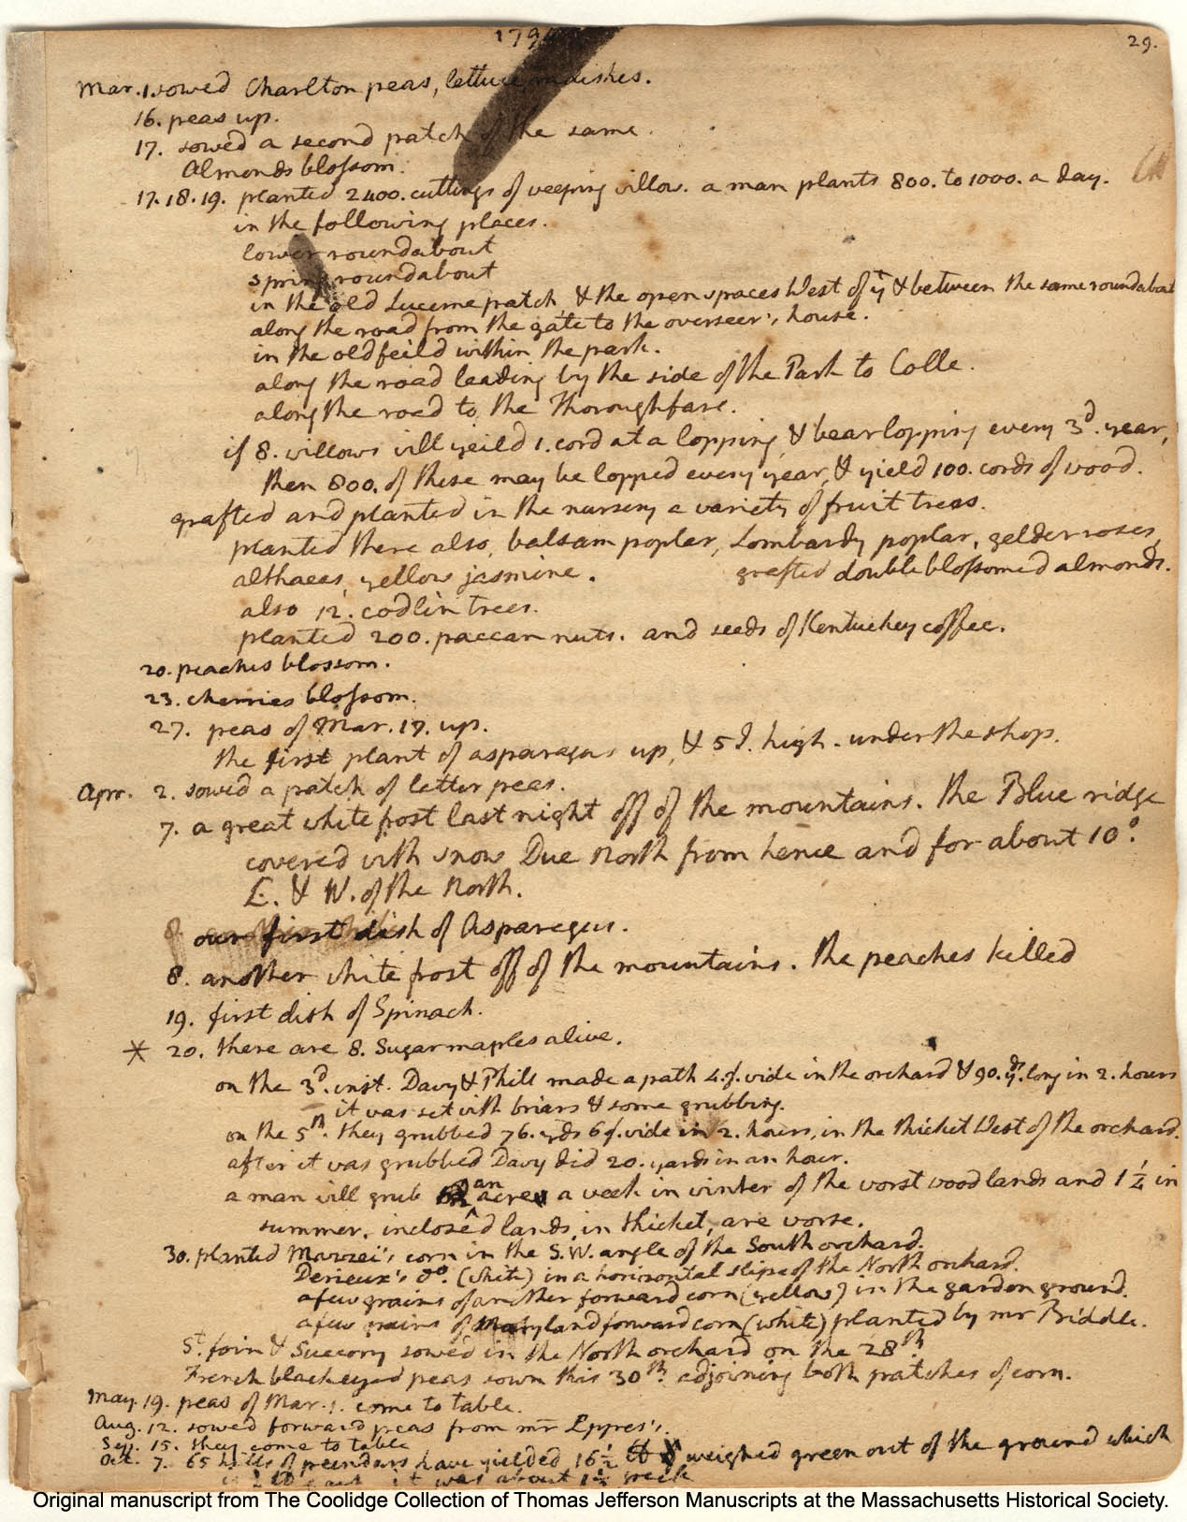
Sustaining A Young Nation
“There is no doubt but that were there hands enough in the Sugar-maple country, there are trees enough not only to supply the U.S. but to carry a great deal to Europe and undersell that of the cane.
The public attention is very much excited towards it, and the high price of W. India sugars will draw these forth.”
Notes:
The reason why it may be cheaper, is that it is the work of women and children only, in a domestic way, and at a season when they can do nothing in the farm.

Slide 5
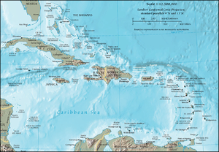
Subject to British Markets
West Indies cane for sugar, molasses and rum was only one product the United States had to buy from the British.
Flour, shingles, steel tools, needles, wheels, plows and guns, liquor and ale, linen and wool, every commodity was purchased from Britain or her colonies—at British prices.

Slide 6
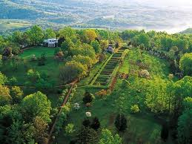
Jefferson Dreamed of Self-Sufficiency
The sugar maple, Jefferson wrote a friend in England, "yields a sugar equal to the best from cane. . . . What a blessing to substitute a sugar which requires only the labour of children, for that which it is said renders the slavery of the blacks necessary."

Slide 7
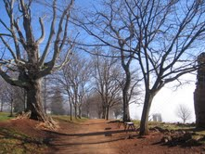
60 sugar maples in 1791
Jefferson planted 60 maple saplings in 1791; all but 8 died. Today, sugar maples line walkways and lawns at Monticello. These may be seedlings or 1880s plantings.

Slide 8
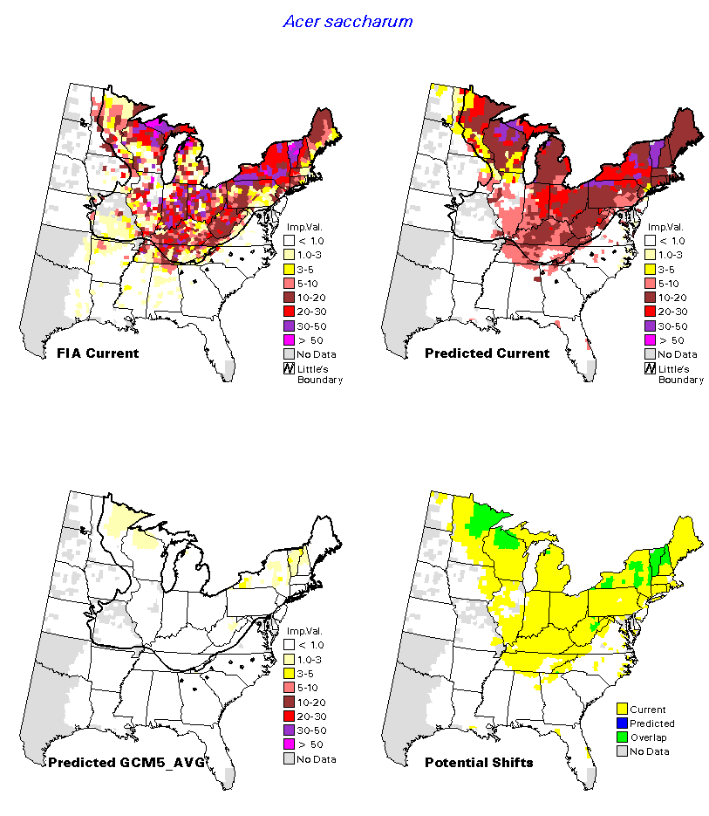
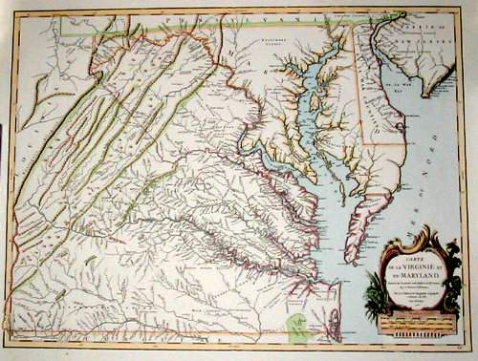
Climate change is projected to eliminate the sugar maple in almost all of its U.S. range.
Monticello is at the southeast edge of the maple range.
Charlottesville

Slide 9
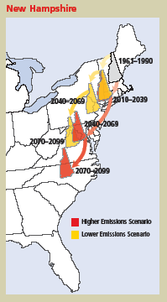
Monticello is in the Virginia Piedmont.
New Hampshire’s climate is projected to become as warm as Virginia’s in climate change models.
Figure from The Changing Northeast Climate: Our Choices, Our Legacy, Union of Concerned Scientists, 2006.

Slide 10
Virginia is Warmer
6º F warmer than New Hampshire

Slide 11
And Wetter
Virginia averages 47” of rainfall annually. New Hampshire—38”.

Slide 12
At the Edge of A Range
In the middle—average, normal.
At the extremes—Abnormal? Stressed? Unusual?
Or---Could a plant growing in the extreme of its range be gifted, special, adaptable, resilient?

Slide 13
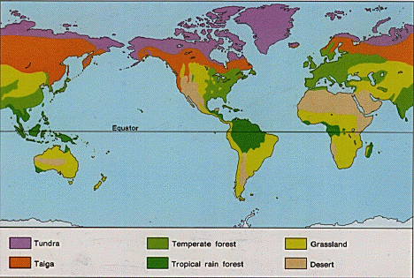
A Tree’s Range and Its Biome
Sugar maples are a dominant species in the temperate forest. The Appalachian forest is the largest temperate forest in the world.

Slide 14
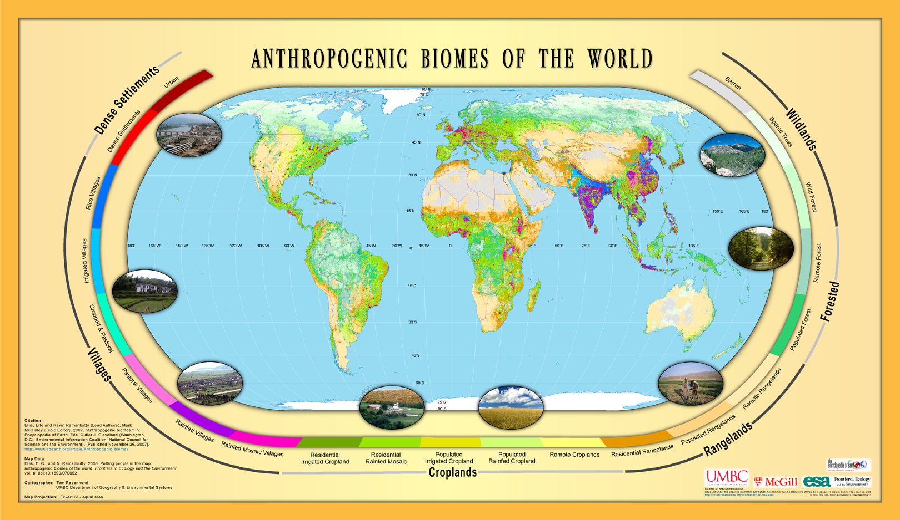
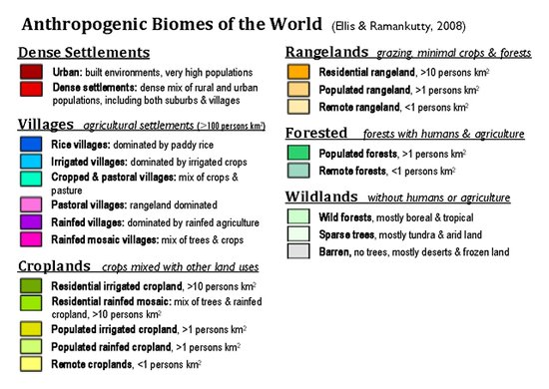
Anthropogenic Biomes
Human beings have changed natural biomes wherever we live around the globe.

Slide 15
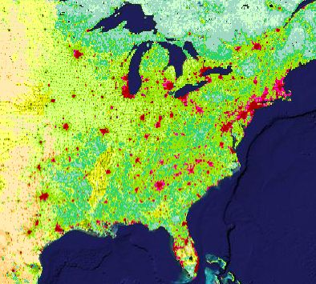
How have humans already affected the maple’s range?
How will climate change, warming temperatures, wetter seasons, and more intense storms affect the maple?
Erle Ellis (Lead Author);Navin Ramankutty (Contributing Author);Mark McGinley (Topic Editor) "Anthropogenic biome maps". In: Encyclopedia of Earth. Eds. Cutler J. Cleveland (Washington, D.C.: Environmental Information Coalition, National Council for Science and the Environment). [First published in the Encyclopedia of Earth January 3, 2008; Last revised Date September 25, 2011; Retrieved February 16, 2012

Slide 16
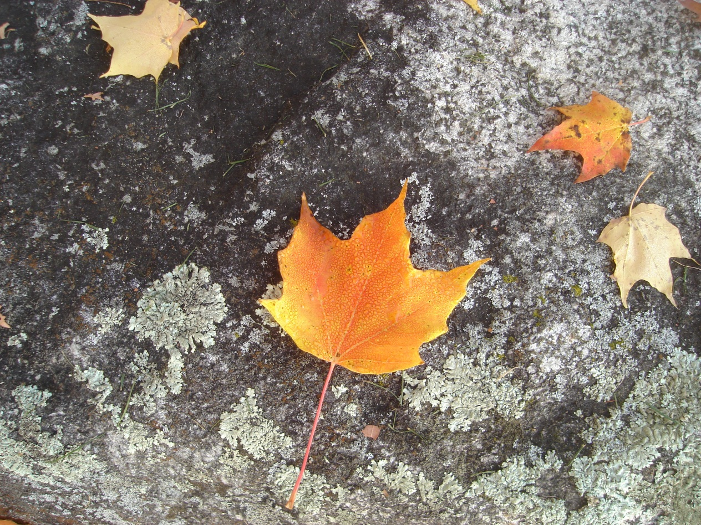
Have the Monticello Maples
Adapted to Southern Climate?
Could maple sap, buds, sugar and phenolic compounds and growth rings in these maples
give us clues as to how New England maples might be adapting to climate change?

Slide 17
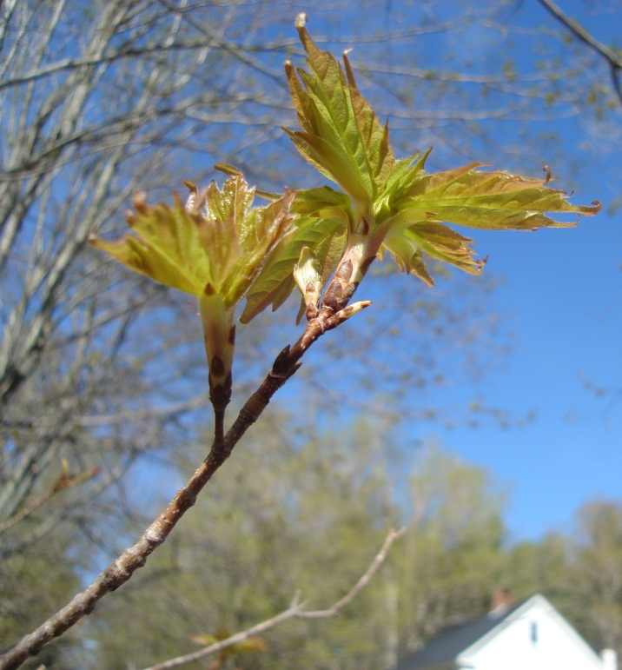
The Deductive Approach: Framing A Hypothesis
Maples at Monticello will display more stress than NH maples.
Plan Protocols and Methods that will elucidate and test one hypothesis.

Slide 18
The Inductive Approach
Prepare to be surprised.
Collect Everything
Notice what is there and what is not there.

Slide 19
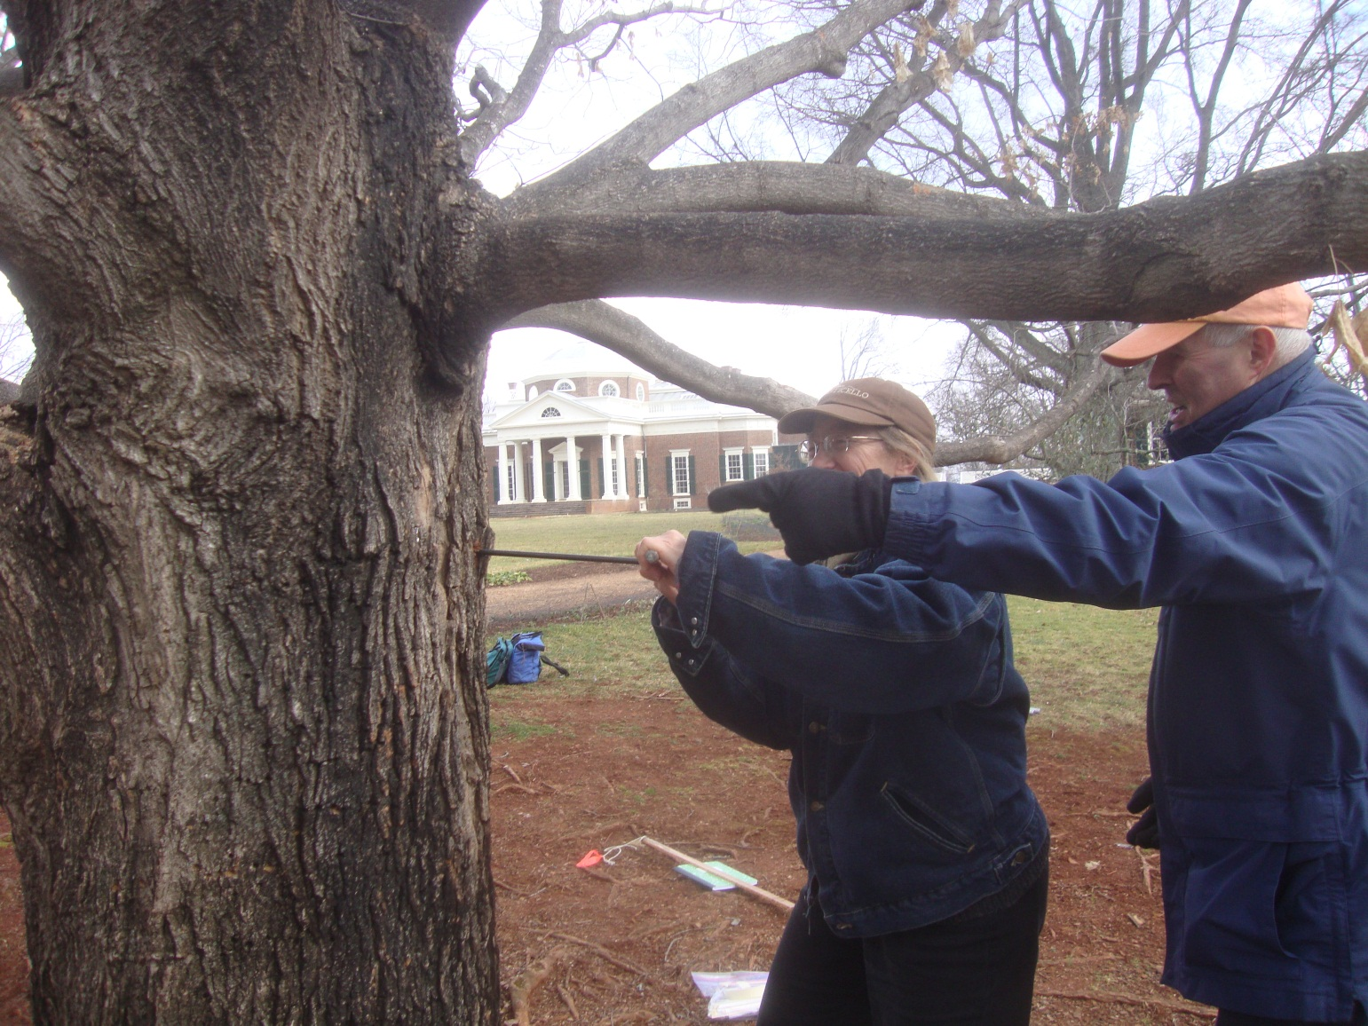
We cored four trees.
Pat Brodowski, a Monticello gardener and Dr. Barrett Rock of UNH, core a maple.
Wood growth, stable isotopes, biochemistry, morphology of wood cells all may give clues about the health and history of these trees.

Slide 20
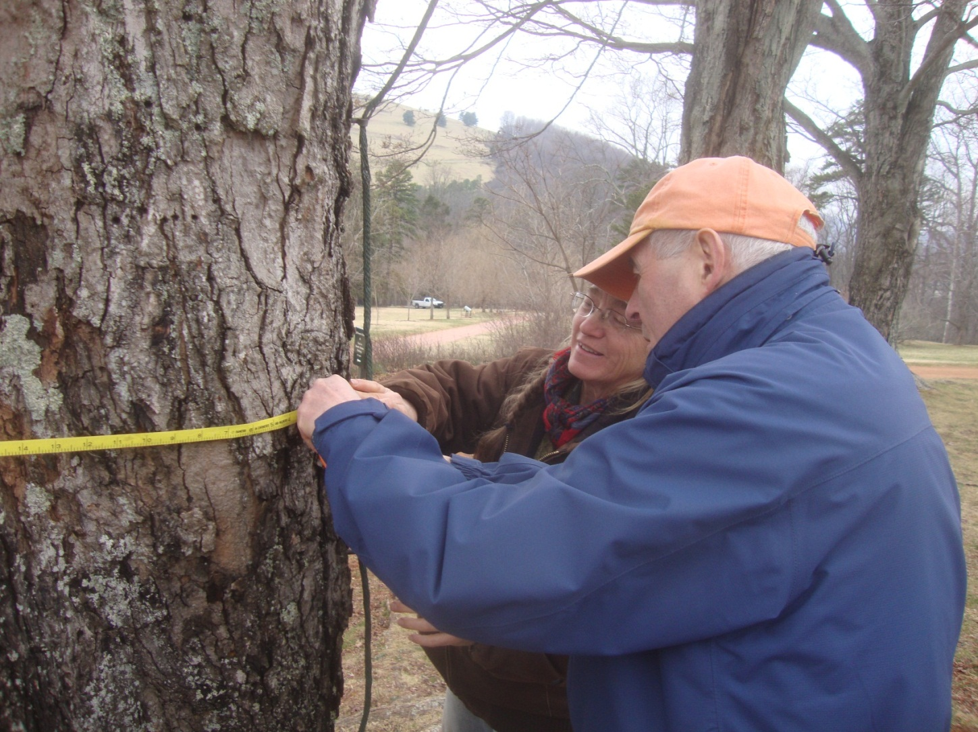
We measured diameter at breast height and height of seven trees.
Is their growth as vigorous, less so or more so, than NH trees’?
Do they respond to warming temperatures and changes in rainfall in the same way that NH trees have responded?

Slide 21
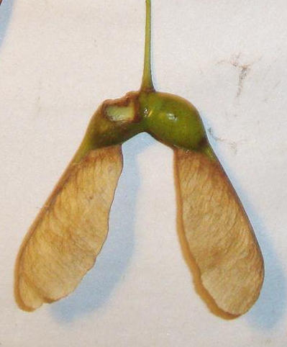
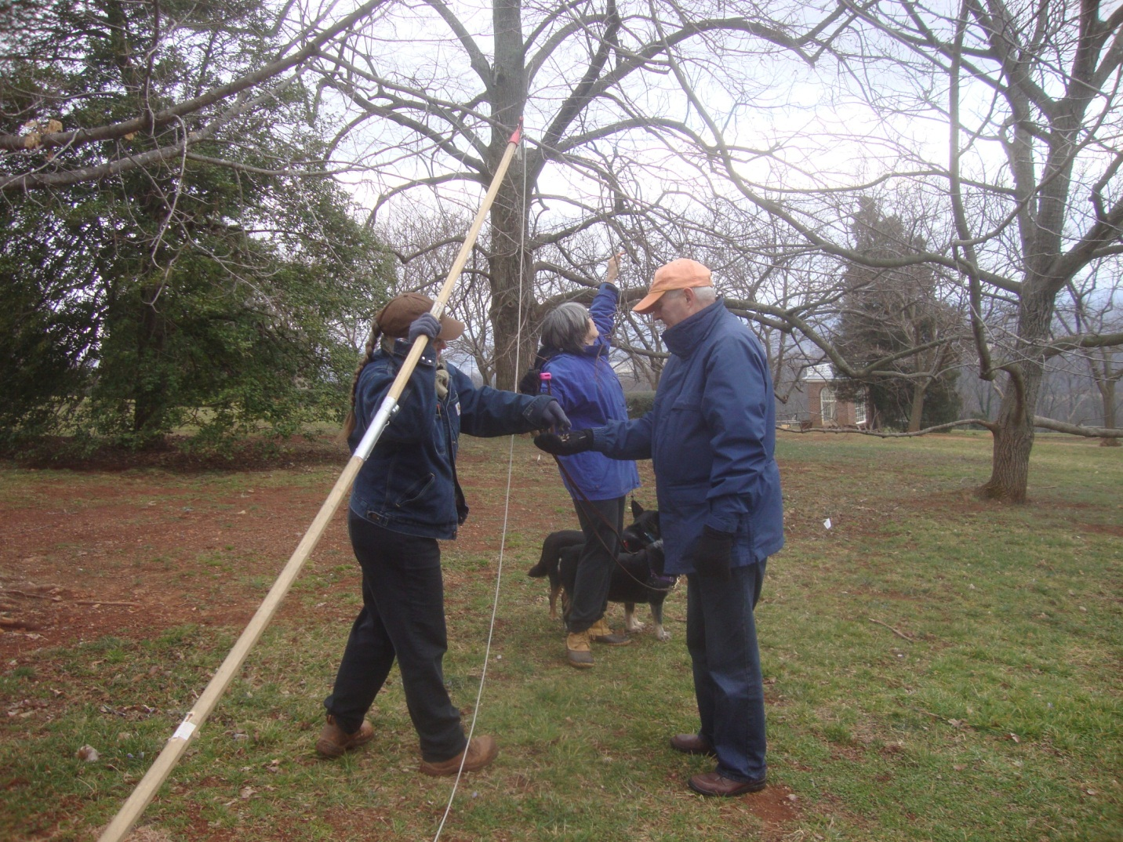
We collected branches and discovered seeds on some.

Slide 22
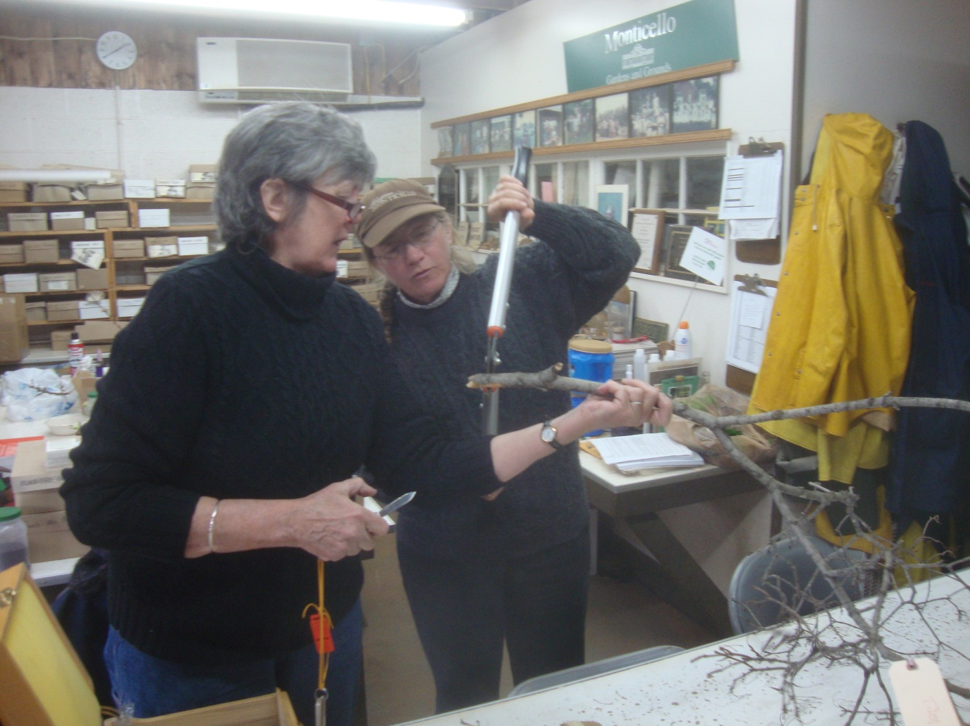
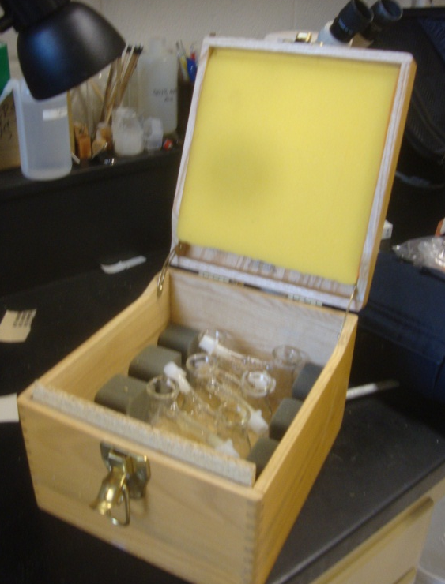
We extracted sap from seven branches from seven trees.
Pat and Martha Carlson, Forest Watch coordinator prepare a branch for sap extraction.

Slide 23
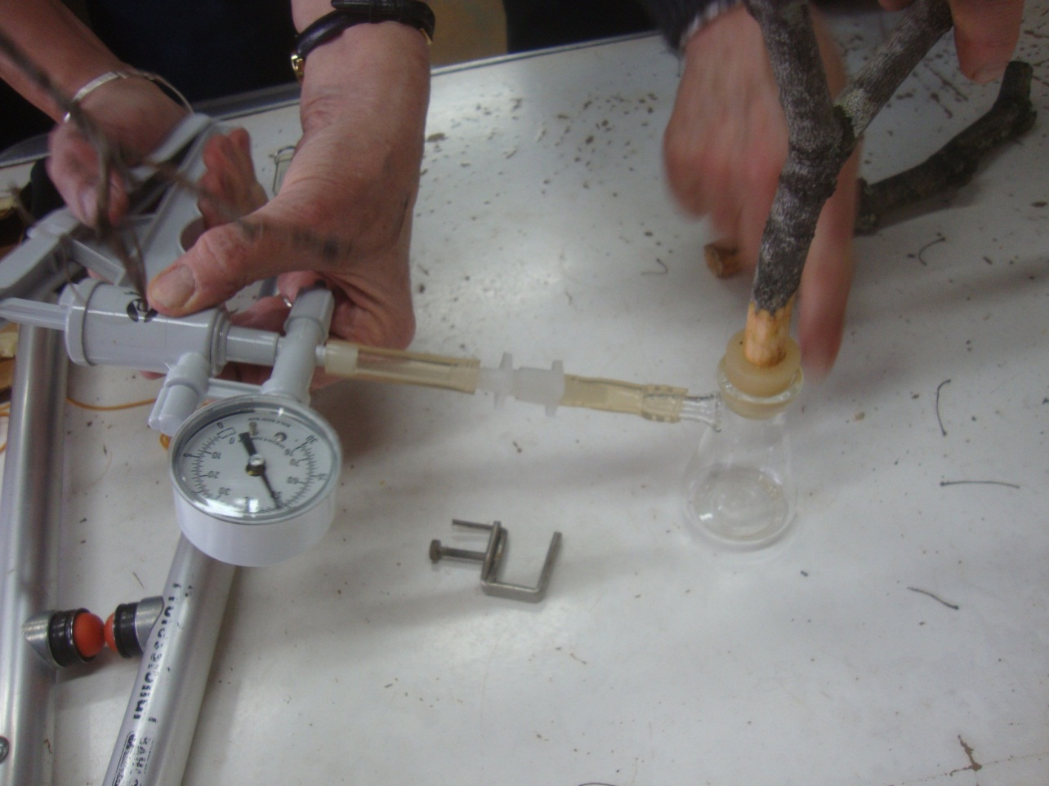
A Vacuum Pump Pulled Sap from Each Branch.

Slide 24
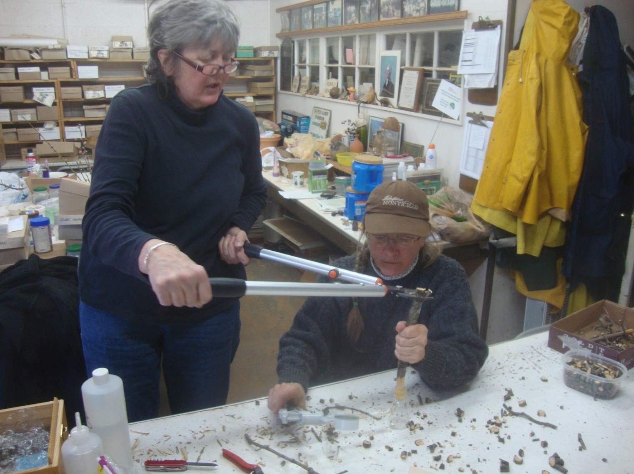
From Top Twigs to Last Stub, Each Cut Produced More Sap.

Slide 25
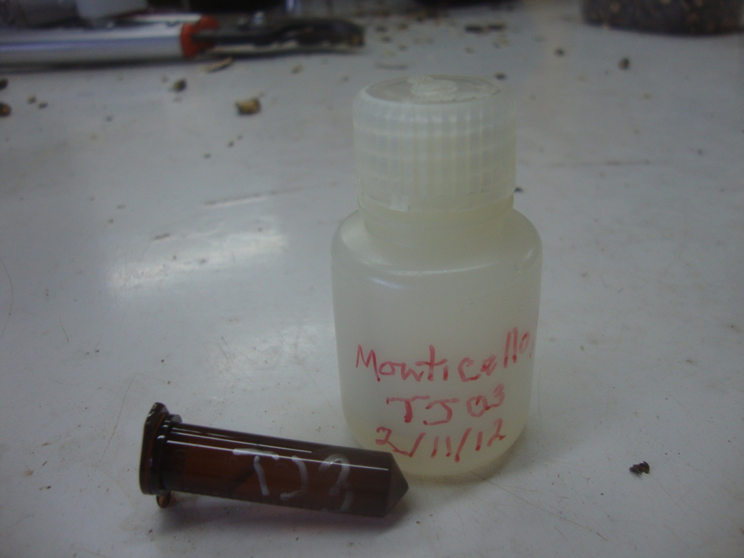
A few milliliters of sap will be tested for total phenolics and 10 individual phenolics—protective anti-oxidants.

Slide 26
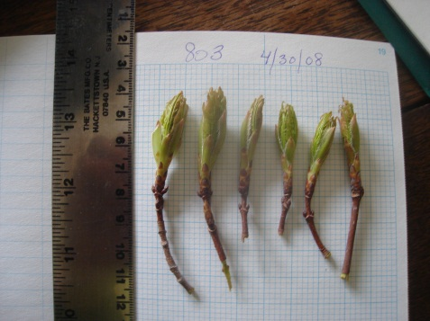
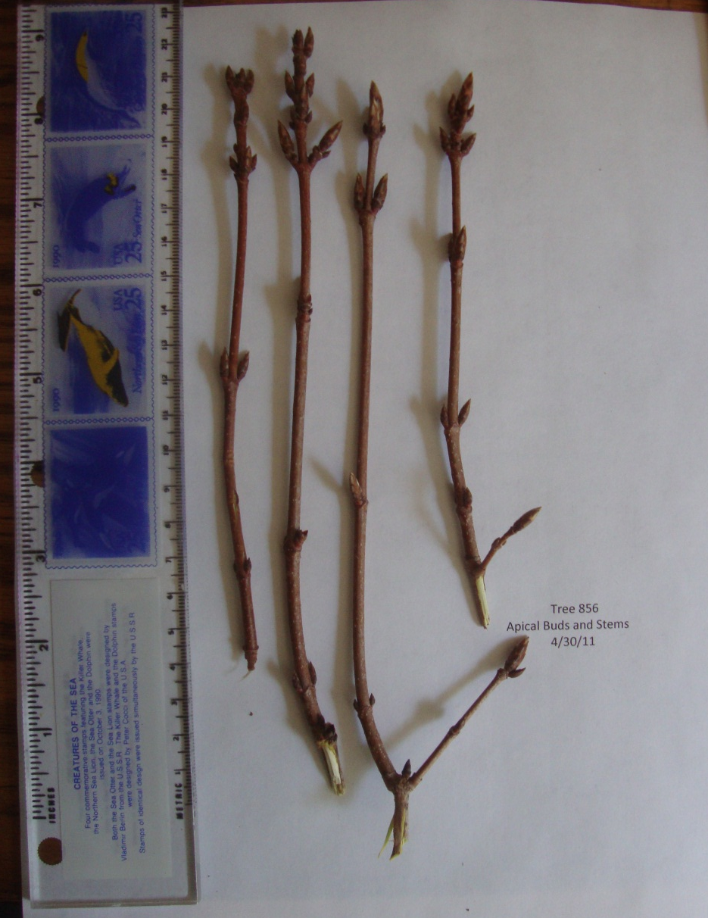
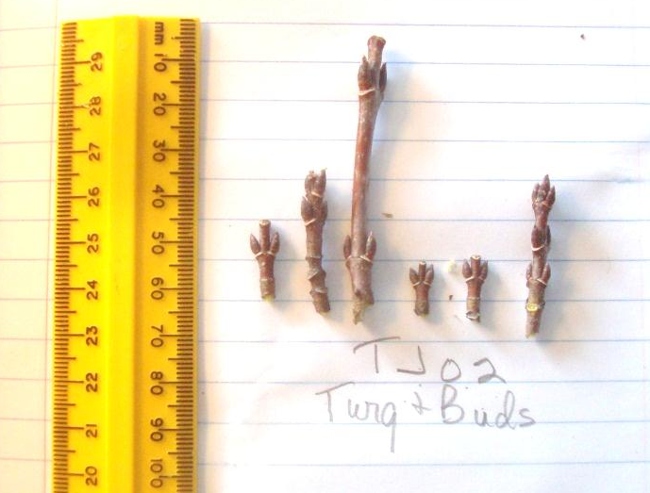
Analysis Begins
Normally, maples put high priority on excellent buds. Even stressed trees produce 75% excellent buds. The rest were dead or damaged.
In 2011, maples in NH were stressed by flowering and seed making, a reproductive necessity.
This year, NH trees produced few excellent buds. But the number of dead or deformed buds was not much more than 25%. Most buds were small lateral (side) buds. Although they are small, these will produce a full crop of leaves in Spring 2012.

Slide 27
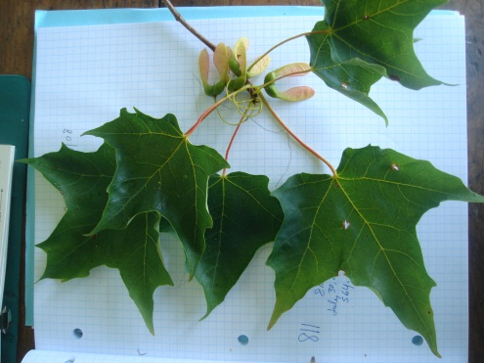
Are Monticello’s Buds in
Poorer Condition?

Slide 28
Are Monticello Trees Just as Healthy?
Sap sugar in Monticello trees appears to be very similar to NH trees’ sap sugar at this time of year.

Slide 29
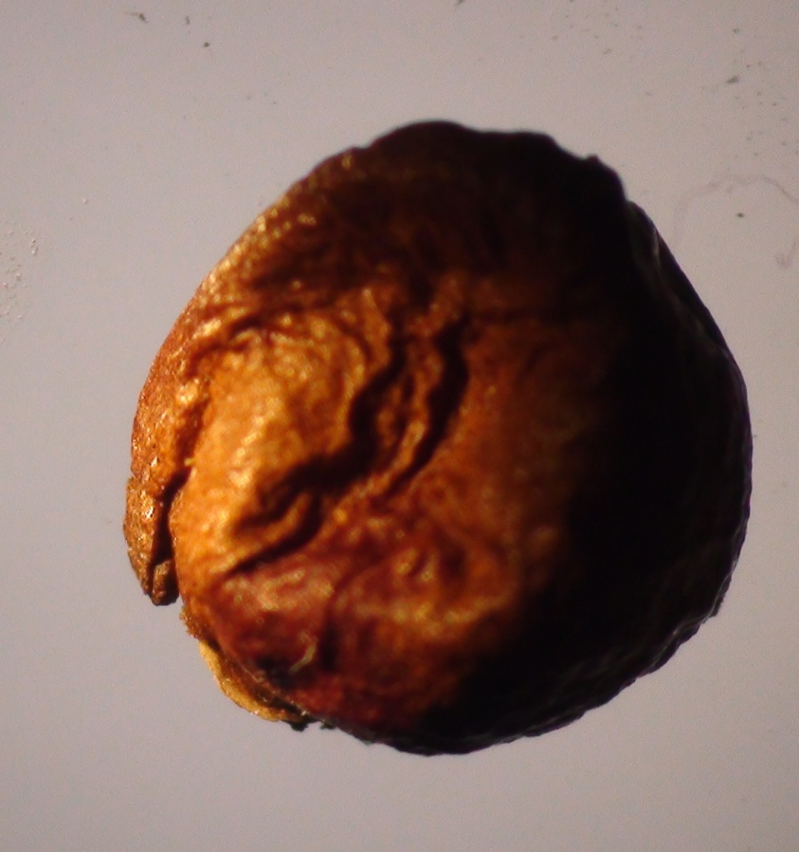
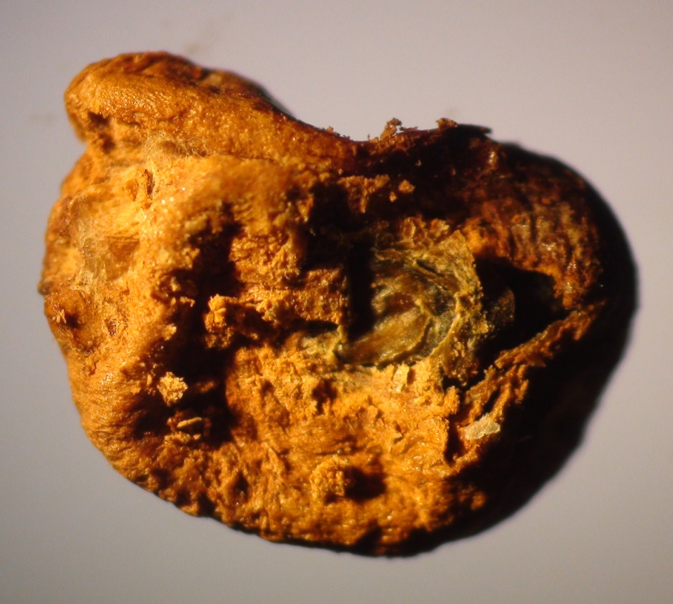
Will the Seeds be viable?

Slide 30
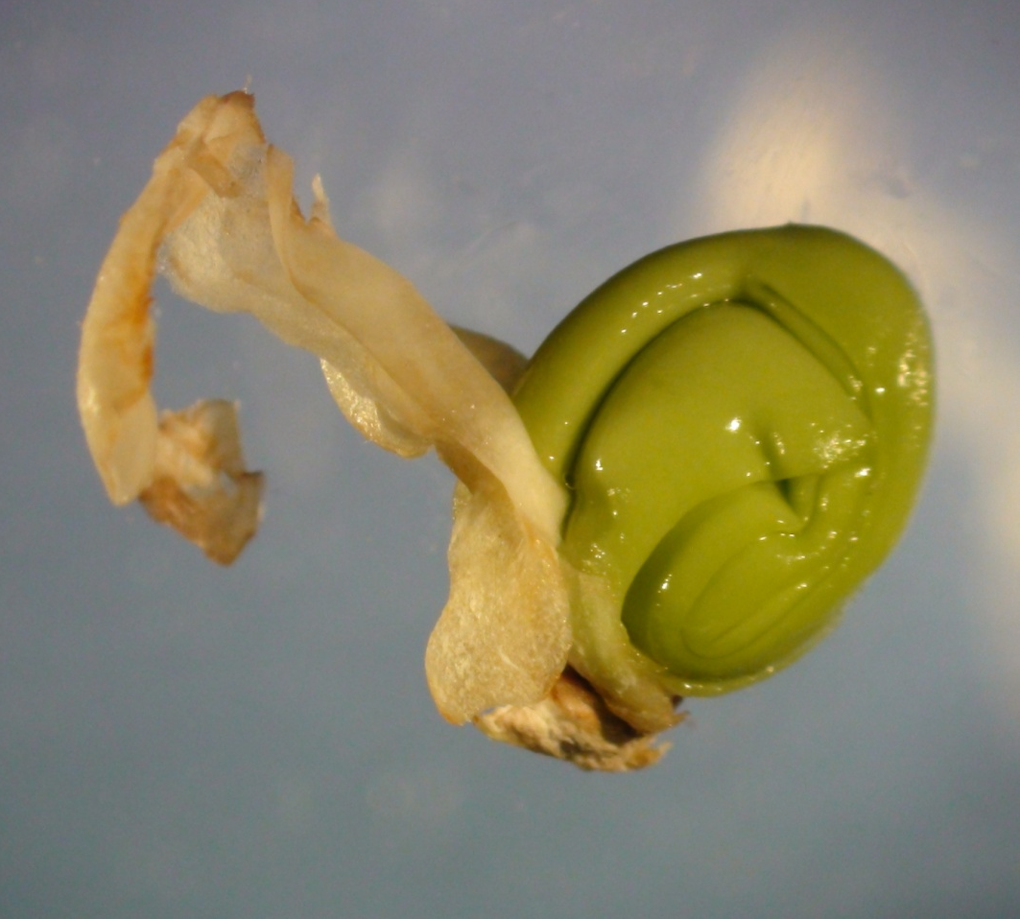
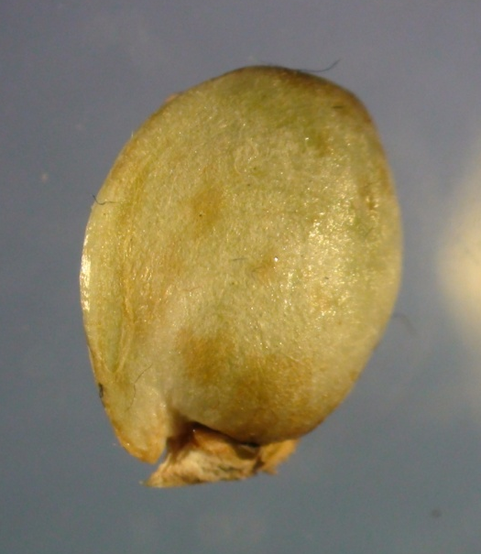
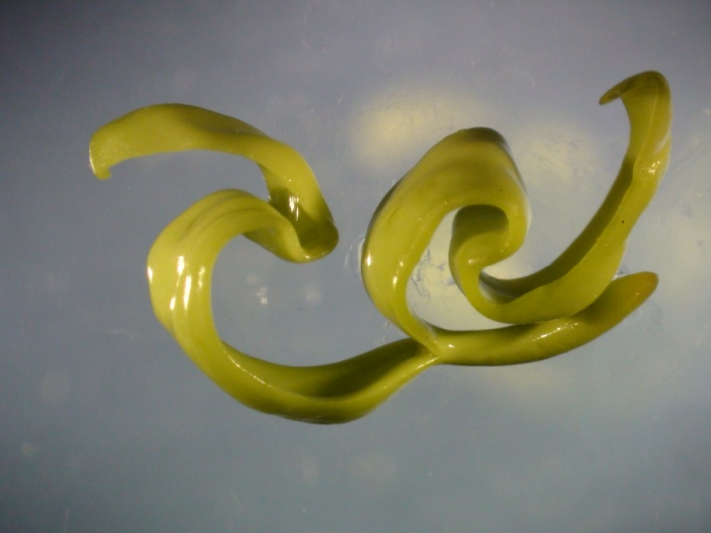
Healthy NH seeds were green last fall, not brown. Are they brown now? Or still green?

Slide 31
“If we knew what we were doing,
it wouldn’t be science.”
"Forests are the lungs of our
land,
purifying the air and
giving fresh strength to our people."
-Franklin Delano Roosevelt

